Slide 1
Level 1
Loading….

Slide 2

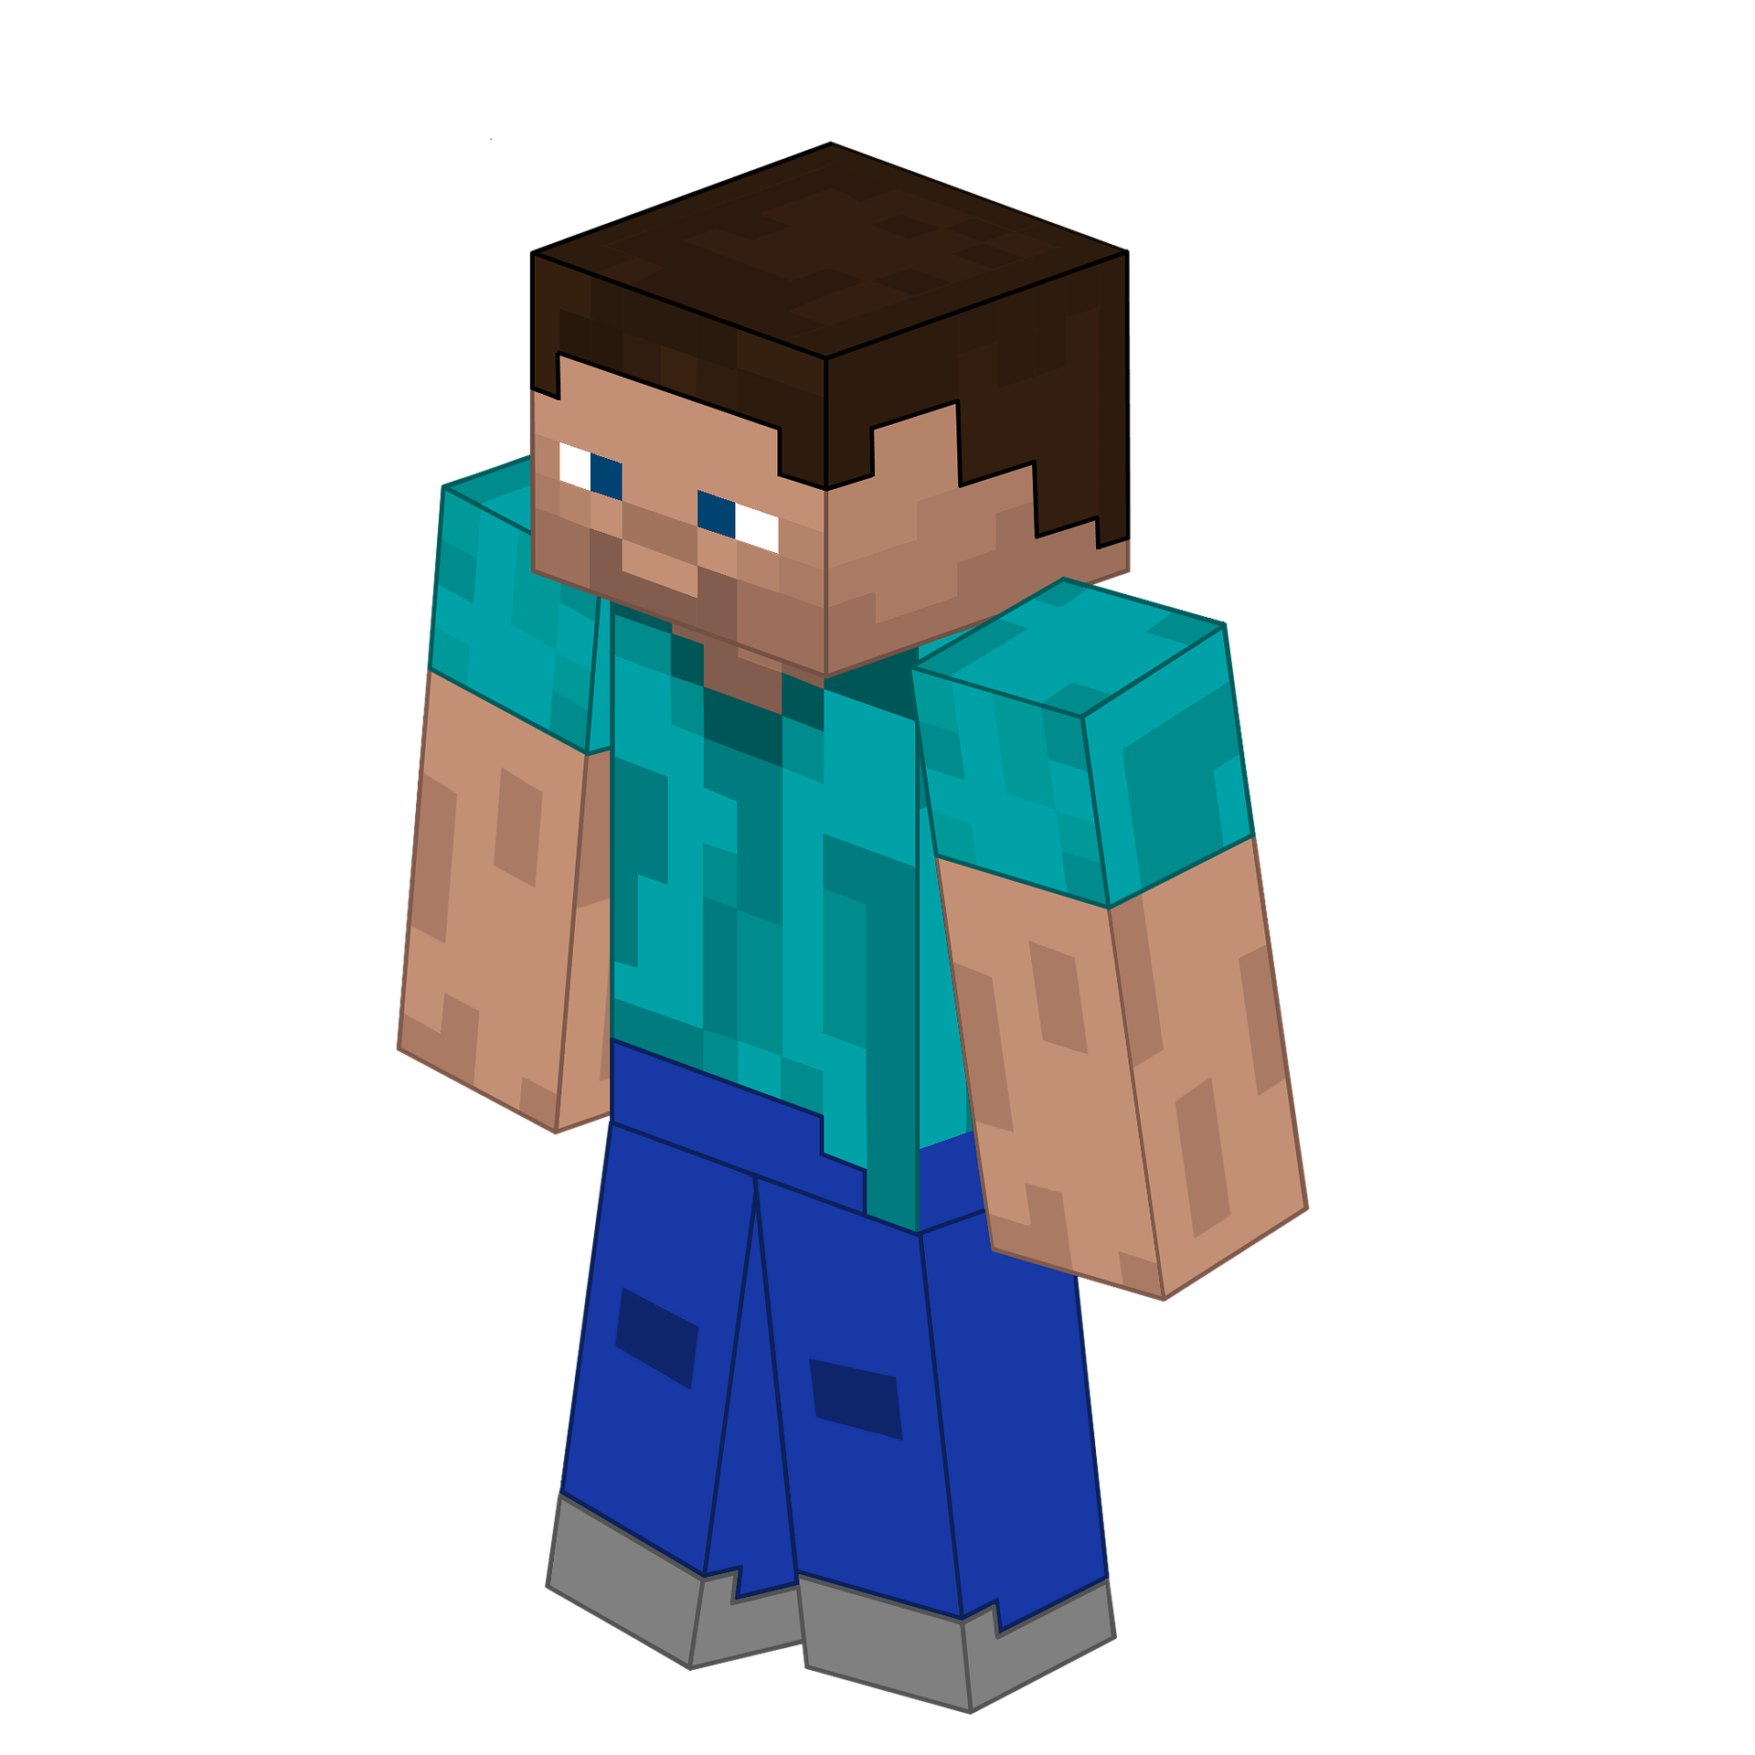

Image Attribution: CCO, from wallpapertag.com

Slide 3
Level 2
You did it!!
Loading…

Slide 4
25
35
5
25
5
50
10
10

Slide 5
Level 3
Level 2 Score
1200!!
Loading…

Slide 6
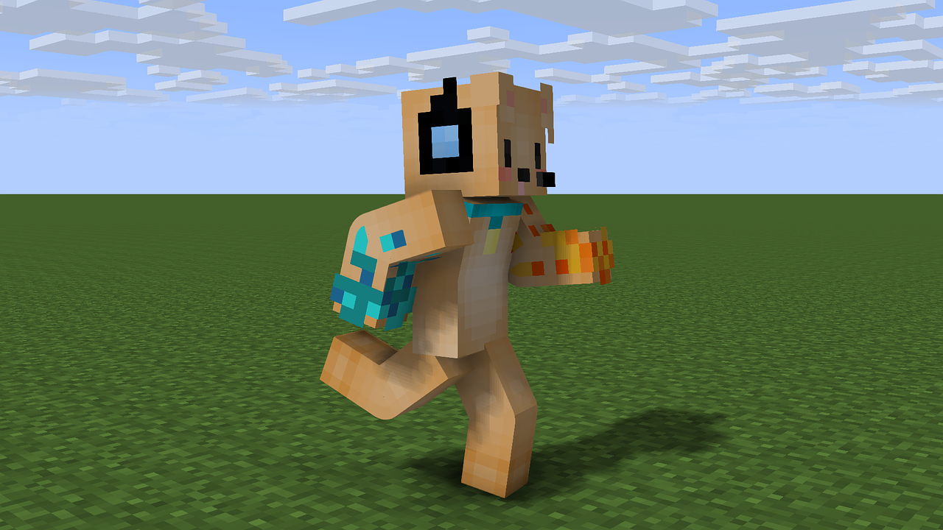
10
10
20
15
5
5
5
10

Slide 7
Level 3 Score
1500!!
Great Effort!!

