Slide 1
Diversity
As an Inclusive Educational Framework that supports all learners and ELL’s
By Heather Fisher
In fulfillment of EDTE 523
Spring 2017

Slide 2
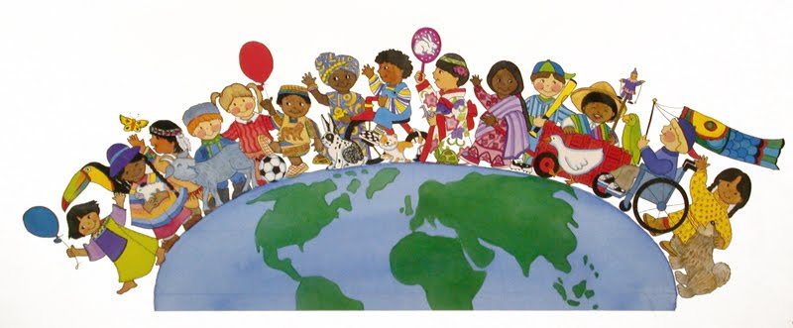
Create a diversity based Inclusive Learning Community for all
Notes:
As an Educator, I believe it is important to create a diversity-based inclusive learning community for all. I will ensure that;

Slide 3
Principles of the diversity based inclusive classroom
Recognize that many aspects of the primary curriculum are truly universal with diverse expressions– i.e. play, art, dance, outdoor exploration, language learning. Children all over the world learn in similar ways during childhood.
Dimensions of diversity such as age, ability, gender, sexual orientation, socio-economic status, family composition, learning styles, culture, ethnicity and language are valued and respected on a daily basis.
Children learn the language of diversity, which includes concepts of equity and equality, in the diverse languages represented in the classroom.
The learners, which includes the teacher who is also a learner, create a class vision statement that supports diversity in the classroom.
All children’s language and cultures are celebrated and woven into the curriculum through family engagement in sharing and learning. This occurs across disciplines. Every family’s dimensions of diversity will be integrated into the learning. This models global citizenship where everyone is celebrated and included.
Digital Literacy is engaged to support the celebration and learning of diversity, which includes cultures and languages.
Conflicts based on differences are viewed as learning opportunities and are resolved using restorative practices that focus on relationship and restitution.
Notes:
Principles of the ‘Diversity-based Inclusive Classroom’.
Dimensions of diversity such as age, ability, gender, sexual orientation, socio-economic status, family composition, learning styles, culture, ethnicity and language are valued and respected on a daily basis.
Children learn the language of diversity, which includes concepts of equity and equality, in the diverse languages represented in the classroom.
The learners, which includes the teacher who is also a learner, create a class vision statement that supports diversity in the classroom.
All children’s language and cultures are celebrated and woven into the curriculum through family engagement in sharing and learning. This occurs across disciplines. Every family’s dimensions of diversity will be integrated into the learning. This models global citizenship where everyone is celebrated and included.
Digital Literacy is engaged to support the celebration and learning of diversity, which includes cultures and languages.
Conflicts based on differences are resolved using restorative practices that focus on relationship and restitution.

Slide 4
Vygotsky and his premise of language acquisition
Language is learned within a social context
Language is a tool for mediating the social world
Developing expressive and receptive oral language skills develop prior to reading and writing skills
The more socially based language is, the more accessible it is to learners.
Notes:
I believe in Vygotsky’s premise that communication is a tool that is developed within a cultural context through social interaction. For younger children who are in the early primary grades, expressive and receptive language are the most important components of language because they are the most useful. For ELL’s, becoming fluent in expressive and receptive oral language is a matter of survival and often develops before reading and writing skills. However, research shows that all four components of language must be learned concurrently for ELL’s to develop whole language skills. One component reinforces the other, for example; listening to a read aloud, while viewing the written words and then participating in a discussion about the story, engages all 4 components of language acquisition within a social context. The more interactive the experience of reading the story is, the more the ELL’s and all children will learn the 4 components of language encompassed in the story.

Slide 5
Practices of the diversity based, language friendly classroom
‘Welcome to the Heart of the Circle’ game
World language lessons with first language speakers from families in the school.
Star of the Week heritage book and sharing themes that elicit dimensions of diversity
Appropriate desk placement for ELL’s – i.e. proximity to the teacher
Appropriate differentiated instruction for all learners
Appropriate differentiated assessment for all learners
Use of comprehensible materials – i.e. images, artifacts, TPR.

Slide 6
‘Welcome’ all the children/languages/cultures to the classroom in the first weeks of the school year by doing inclusive games and activities that teach words and phrases in the diverse languages represented in the classroom. Engage students in co-teaching words and phrases.
Focus on a language of the week and re-learn the basic greetings of that language each day during Calendar. By the end of the week, learners should be able to say, “Hello and Welcome. How are you? I am well, thank you”.
Represent languages spoken by students on a diversity word wall – a map of the world with language families written on it in the location where the languages originate.
Create an attention getting song that uses the multiple languages represented in the classroom.

Slide 7
Include the diverse cultures/languages represented in the class in the learning plan as often as possible
Provide ELL’s with notebooks that they can use to create first language/English language dictionaries for themselves. This can be sent home to be checked by parents that are fluent in the first language.
Invite parents who are fluent language speakers to share the home language in the classroom through a variety of age appropriate language games. These games should integrate discplines – i.e. a nutrition themed game in French that can be done in PE.

Slide 8
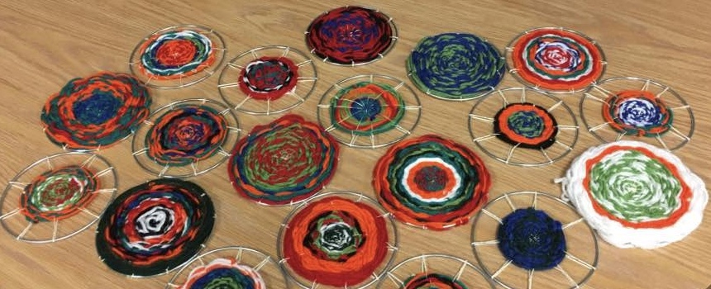
Examples from practicum
Notes:
Like the beautifully diverse weavings in this photo, my grade 1 practicum class was linguistically an culturally diverse, representing 6 languages. 4 students were receiving additional ELL support. To meet the language needs of all the students, I used a research-based method called ‘Interactive Read-Alouds’, whereby I used concrete objects and actions to teach new vocabulary within the context of a story. I found that all the children in the class responded to this approach and that it helped the ELL’s with all 4 components of their language acquisition

Slide 9
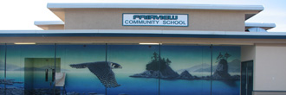
Examples from work in SD 68
Notes:
Currently, I am extending my learning of second language acquisition by working as an EA 3 days a week at Fairview Elementary and 2 days a week at Quarterway Elementary, which is a French immersion school. My role at both of these schools has everything to do with language acquisition, so I consider myself very fortunate to have the opportunity to be an EA for the last 6 weeks of the school year.
As you may know, Fairview is the receiving school for the Syrian families. There are Syrian learners in every class and one of my job functions is to support language acquisition for a grade 3 Syrian student who arrived in 2016 and is at about level 1 in all areas of English language acquisition. This child has been under stress as he is currently participating in his first experience of Ramadan, and cannot eat while he is at school. I have been assisting him by taking him out of his classroom when the other children are eating their snack, as he sometimes becomes tearful when he sees food. He is learning phonemes through a workbook, however, my primary focus when I see him is to engage him in conversation. He is much more proficient in expressive and receptive language than he is in reading and writing. I also find that engaging in conversation with him allows me to convey care and concern for him and build rapport. I am planning to do some language games with him so that he can learn the phonemes in a social context before writing them in his workbook. I will also be bringing in some Arabic books from the public library so I can read an English Arabic book with him. Given that he was 7 years old when he arrived in Canada, he is proficient in his first language, Arabic. In this course, I learned the importance of supporting first language development. Research shows us that children learn their second and subsequent languages faster when they continue learning their first language and can make connection between their first and subsequent languages. Providing children’s literature in all the first languages in my classroom

Slide 10
Digital literacy
Notes:
In my practicum I saw firsthand how digital literacy supports language acquisition through the Reading Eggs Program. While I do not see myself creating digital language learning platforms for ELL’s, I recognise that they are effective learning tools that support the development of language. As an educator, I will continue to be the primary mediator of learning for my learners, however, I recognise that the internet is a polyglot and I am not. I will support the use of research-based digital resources to support language acquisition. I understand that digital literacy is a complex field of study within education that is also becoming a universal language for learners. It is connected to global citizenship and must be a cornerstone of 21st century education. I plan to act in accordance with the guidelines within the school district I work for and follow the guidance of digital literacy learning experts within the school system. Some of the best digital literacy practices for the primary classroom include using online coding programs, having students create e-portfolios to represent their learning, using internet-based research in inquiry projects, and using translation and language learning programs.. One of the things I love about digital literacy is the ease of integrating it into the home environment.

Slide 11
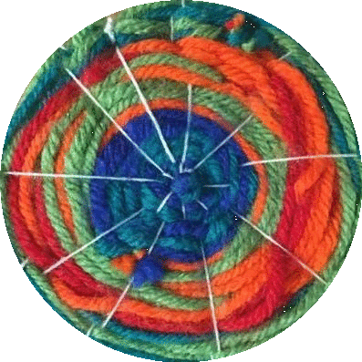
literacy
Write your own book, listen to audio books
Writing prompts, writing games, free writing, buddy editing
Word banks/word walls and personal dictionaries
Interactive Reader’s theatre with mixed language resources. I.e. for ESD communities.
Good Fit books at the instructional level for each child
Pre-, During-, and Post- reading strategies – i.e. CAFÉ Program.
1 tier, 2 tier and 3 tier vocab words
Sight words
Use of artifacts as pre-reading tools for understanding
A variety of drawing and graphic writing tools – ‘reports’, ‘books’.

Slide 12
Visual art
Recognize that art-making is a universal human experience connected to communication!
Do multicultural art! Art that connects across cultures – i.e. circular weaving
Connect language and Art by doing word art! (i.e. name mandalas) and encouraging oral language during art making
Connect art materials and techniques with symbology to encourage ‘story-telling’ with art
Connect music and art by playing culturally diverse music connected to the art making
Paint Your Dance! – do interpretive dance to diverse pieces of music and explore the emotions, then paint your feelings afterward ☺))))
Connect math and art through color theory and shapes (geometry)
Focus on art lessons that represent the diverse cultures represented in our community of learners. Engage family members in art-making.
Connect art to outdoor ed by making art in and of nature materials

Slide 13
pe and health
Teach nutrition using food examples from diverse diets
TPR – Total Physical Response games and activities connecting language acquisition to kinesthetic learning. The possibilities are endless!
Make Your Own Game/Make Your Own Dance – bridges cultures and languages, allows multi-lingual children to choose how to express themselves.
Teach diverse cultural folk dances from cultures represented in the classroom, integrate songs and the languages from the diverse cultures.
Simplify visual and verbal cues during lessons
Play experiential learning and active games that emphasize verbal and non-verbal communication among learners.

Slide 14
Social studies
At the primary level, languages and cultures are learned through connection to the self and family.
Explorations of diversity should be as place and family-based as possible, i.e. exploring cultural connections within the families, class and school.
The social studies curriculum can be woven into any/all other curriculum areas where language and culture are concerned.
Some of the best practices may include; potlucks, heritage fairs, world language lessons, diverse cultural dance lessons, literature that represents dimensions of diversity, self-directed inquiry into different languages/cultures.

Slide 15
math
Math Carnival – introduce and/or play a variety of math games using the theme of a carnival (stations that learners rotate through). The key here is to get help from big buddies who can teach the game to the primary students
Connect Authentic Math to Outdoor Ed as often as possible – i.e. use appropriate nature items as math manipulatives. Shells and sticks can be used to teach all primary level math concepts!! Knowledge transfer from outdoor context to paper, or paper to outdoor context – recognizing that doing or showing is often easier than telling or writing for ELL’s.
Mathletics - use a variety of digital resources to support ELL’s and other learners
Use multiple ways to show a concept. Use comprehensible input, culturally appropriate examples to show content

Slide 16
Music/theatre
Music is itself a universal language that encompasses the world’s diversity. It can be a vehicle for understanding the diversity of language, art, and culture.
Connect diverse musical genres to other culturally based activities. I.e. if learning to cook a cultural dish or doing an art activity from a particular culture, play music from that culture.
Use music and theatre to bridge differences and bring learners together.
Theatre bridges language music and art and is a vehicle for diverse forms of expression.

Slide 17
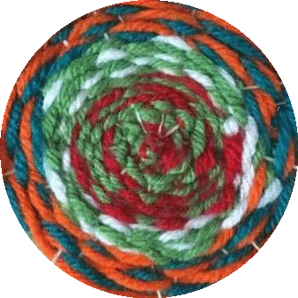
Science/outdoor ed
When science is hands-on and experimental, it becomes concrete, tactile and more easily understood across languages.
Outdoor learning allows learners to communicate in a variety of ways, perhaps with more body language than they are permitted in the classroom.
The freedom of expression that comes with outdoor play and learning has also been found to be universal across cultures in that young children tend to have common patterns in their play in nature – i.e. building structures, playing with mud and making paths and small worlds.
Scientific vocabulary can be translated into languages other than English as necessary.

Slide 18
Summary of learning
This course provided me with deeper insight into developing my own framework for understanding language acquisition. I learned about new practical and digital tools, strategies and resources that I can use now as an EA, and in my future teaching practice. I believe this course helped me integrate language acquisition into my diversity-based teaching philosophy.
I would like to re-state that diversity is not simply a concept that we teach or a set of techniques and lessons that we can do as part of a social studies unit. Diversity is a foundational value in education that supports the development of a global citizenry that sees and celebrates diversity. Diversity is an innate quality of the universe in which we live and we must understand and celebrate it to create a fair and just Canadian society.

Slide 19
Future directions
Continue working en francais a l’ecole Quarterway
Explore French and Arabic language resources for my own language learning so I can better support learners
Learn how to properly use District Language Assessment tools to formally assess learners’ English language proficiency
Research digital tools for language learning.

Slide 20
Sources Used
Course readings and materials
Mind maps made in class
Conversations with other educators
Real experiences during practicum and working in SD 68.

Slide 21
Artwork created by Ms. Fisher’s Grade 1 class during the 5 week practicum

